Slide 1
Social network structure and composition in former NFL football players
Amar Dhand, Liam McCaferty, Rachel Grashow, Ian M. Corbin, Sarah Cohan , Alicia J. Whittington , Ann Connor , Aaron Baggish, Mark Weisskopf, Ross Zafonte, Alvaro Pascual‑Leone & Albert‑László Barabási
Shawn George

Slide 2
Overview
Social Networks, Health, and Quality of Life
Biopsychosocial Factors and Brain Trauma
Clinical
Pathological
Characterization of Social Networks Missing in studies of contact sport athletes

Slide 3
Plan
Background
Methods
Network Instrument
Data Collection
Network Analysis
Statistical Analysis
Results
Discussion
Football Players With Chronic Illness and Football Players Without Chronic Illness

Slide 4
Background: Personal Social Networks
Personal Social Networks
Family, Friends, Acquaintances, Interpersonal Connections
Broad Effects on Health and Quality of Life
Social Influence, Neurohumoral Cascades
Contact Sport Athletes and Social Networks
Mitigate brain trauma, quality of life
Separation of the studies in social networks and brain trauma

Slide 5
Background: American-style football players and illness
Chronic illnesses
Neurodegenerative disorders, chronic traumatic encephalopathy, Alzheimer’s disease, amyotrophic lateral sclerosis
Additional Illnesses
Cardiovascular Endocrine, mental health
Physiological stress and trauma

Slide 6
Background: Study of Sociality
Unmet need
Not all players experience diseases despite similar brain trauma history
Link between exposure and outcome unclear
Modified by other factors that elevate or reduce risk
Biopsychosocial factors
Social network changes
Retirement adjustments
Financial status

Slide 7
Background: Personal Social Network Mapping
Studied personal social networks of former NFL players compared to non-football US males
Personal Social Network Mapping (Egocentric Network Analysis)
Social support, access to resources, health habit influences, time available to socialize
Examines one on one relationships
Links to each other, demographic and health-related characteristics
Network Structure
Quantitative description of social ties (network size/density)
Network Composition
Characteristics of network members (percentage of kin and diversity of race)

Slide 8
Background: Aim
Characterize personal networks of former NFL players compared to non-football controls (contextualized view)
Hypothesis: Former NFL players will have constricted personal social networks compared to US controls
Credibility
Personal Social Network Mapping and health outcomes
Stroke
Multiple sclerosis

Slide 9
Methods
Social Network survey completed by two cohorts
NFL players enrolled in the Football Players Health Study at Harvard University (FPHS) in 2019
Non-football US controls enrolled in the Genes and Environment in Multiple Sclerosis Study in 2017
Former NFL Players
Played after 1960 (adoption of hard shelled helmets)
336 of 3506 in the cohort responded to the survey and 33 were removed due to incomplete survey responses leaving 303 participants from this survey
US Controls
Asymptomatic male family members of patients with Multiple Sclerosis from a prior study
269 of 1493 completed the survey

Slide 10
Network Instrument
Personal Network Survey for Clinical Research (PERSNET) was the instrument used and contained 3 sections
Name generator
Network inter-relater
Name interpreter

Slide 11
Name Generator
Name generator asked three questions
“Who do you typically discuss important matters with?”
“Who do you often socialize with?”
“Who provides support for your health needs?”
Participant could respond with an unlimited number of names
Network size could be calculated without a ceiling

Slide 12
Network Inter-Relater and Name Interpreter
Network Inter-Relater
Participant asked to describe the presence and strength of inter-connections with the first 10 network members
Name Interpreter
Participant asked to describe all network members’ demographics, health habits, and affiliatioins with the participant

Slide 13
Data Collection
Participants received an email and completed the survey in 10-20 minutes on a computer or mobile device
Football Players received
Information about their personal network
Network map
Social Network characteristics
Information about general effects of networks on health
Quality control procedure ensured surveys were completed correctly

Slide 14
Data Collection
Demographic, football exposures, and health data were taken from the Health and Wellness Survey completed by the participants between 2015 and 2019
Race, marital status, football experience, concussion symptoms, mood, current body mass index, smoking status
Chronic health conditions were taken from a prior study of the cohort of NFL players (determined by medication taken at the time)
Neurocognitive affliction, pain affliction, cardiometabolic affliction, sleep affliction,
Chronic health conditions assigned to US controls
If they stated yes to any symptoms that chronically affected walking, use of arms and hands, vision, speech, swallowing, thinking, memory or concentration, numbness, tingling, burning sensation or pain, controlling bladder or bowel

Slide 15
Network Analysis
Two main categories of personal network metrix
Network Structure
Quantitative description of the arrangement of social ties
Network Composition
Metrics that summarize the characteristics of network members

Slide 16
Network Structure: Metrics
Network Size: Number of individuals in the network (excluding the participant)
Density: Number of actual connections among individuals in the network divided by the number of possible connections in the network (excluding the participant)
Constraint: Degree to which each network member is connected to the others in the network (additional benefits of incorporating hierarchies and strength of ties)
Effective Size: Number of non redundant members in the network (conceptually an inverse metric of constraint)
Maximum Degree: Highest number of ties by a network member (excluding the participant)
Mean Degree: Average number of ties of a network member (indicating distribution of ties

Slide 17
Network Composition: Metrics
Focusing on key features that define the social and health factors of the participants
Diversity of Sex: Mix of men and women in the network (based on the index of qualitative variation)
0 means all network members re one sex
1 means there is an equal number of men and women
Diversity of Race: Mix of races in the network
0 means all persons are the same race
1 indicates an equal proportion of each racial category (“White”, “Black”, “Other”)
Percentage of Distant Ties: Percentage of people who live more than 15 miles from the participant

Slide 18
Network Composition: Metrics
Percentage of Kin: Percentage of people who are family (including spouse)
Standard Deviation of Ages: Range of ages of network members
Percentage of Nnn-Exercising Ties: Percentage of people who do not exercise at least 3-4 times per week
Percentage of Negative Ties: Percentage of network members who the participant reported as having a negative influence on his health
Percentage of Persons who Played Organized Football
Percentage of Persons who Played in the NFL

Slide 19
Network Composition: Metrics
Homogeneity: A feature that sees whether or not participants were surrounded by individuals who were like them
Majority Male Score: Number of men - number of women divided by the total number of network members (-1: majority female to 1: majority male)
Proportion of Network Members with the Same Race as the Participant (0: All different race, heterogeneous to 1: All same race, homogeneous

Slide 20
Statistical Analysis
Compared the median values and categorical distributions between the two cohorts
Used multivariate linear regression to compare the groups
Dependent variable was a network metric like network size
Independent variables were either a cohort or the covariates
Covariates: age, race, education, employment status, median yearly income, domestic status
Covariates used because of differences in these categories between the two groups or they were described in previous literature to be influential on social network formation
Stratifications according to race and chronic illness number and types

Slide 21
Results: Health and Demographic Data

Slide 22
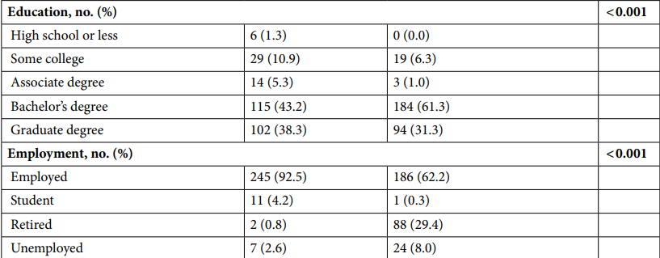
Results: Health and Demographic Data

Slide 23
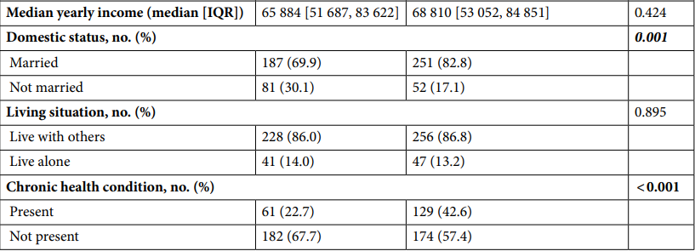
Results: Health and Demographic Data

Slide 24
Results: Social Network Structure

Slide 25
Results: Social Network Structure
Hypothesis: Former NFL players will have constricted personal social networks compared to US controls
Network Size
Former football players: 2575 network members in all
US Controls: 2305 network members in all
Did not differ among controls and football players after accounting for age, race, education, employment status, median yearly income, and domestic status
Median, Interquartile Range
Football Players 8 [5,11]
US Controls 7 [6,10]
All other network typology metrics were not statistically different

Slide 26
Results: Social Network Composition

Slide 27
Results: Social Network Composition
Composition differed in two ways
Football Players had more men than women in their networks as seen by a lower median [IQR] for Diversity of Sex
NFL football players: 0.84 [0.64, 0.96]
US Controls: 0.94 [0.83, 0.98]
Football Players had less family members in their networks than US controls
NFL football players: 40.00%
US Controls: 42.86%
In main comparison all other social network composition metrics were the same

Slide 28
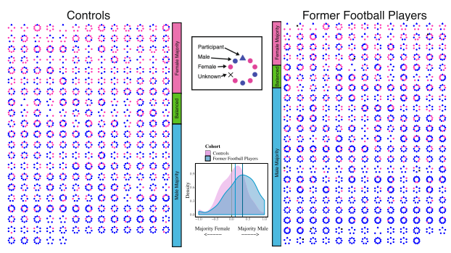
Results: Diversity Of Sex

Slide 29
Results: Social Network Composition
Football Players were also asked about football affiliations
Networks had a median 40.00% of members that played organized football
Networks rarely had members who played professional football
196 (64.9%) had no NFL contacts
91 (30.0%) had only one NFL contact
14.29% were former teammates and coaches in organized football
0.00% of network members were former teammates or coaches at the professional level

Slide 30
Results: Network Structure Stratified By Race
Stratified the football players’ cohort into White (n=222) and Black/Other (n=79)
Compared each group to each other then to the US controls who were 96% White
Network Structure did not differ between the race sub-groups and the controls (no difference from full group findings)

Slide 31
Results: Network Composition Stratified By Race
Black/Other former football players had much higher diversity of race amongst network members
Diversity of Race:
Black/Other former football players: 0.42 [0.06, 0.78]
White former football players: 0.00 [0.00, 0.00]
US Controls: 0.00 [0.00, 0.26]
Other Metrics
Diversity Of Sex:
Black/Other former football players: 0.89 [0.72, 1.06]
White former football players: 0.83 [0.63, 1.03]
US Controls: 0.94 [0.83, 0.98]

Slide 32
Results: Network Composition Stratified By Race
Other Metrics
Percentage of Kin:
Black/Other former football players: 50.00 [22.92, 66.67]
White former football players: 40.00 [22.22, 60.00]
US Controls: 42.86 [33.33, 47.48]
Percentage of Distant Ties (more than 15 miles from the participant):
Black/Other former football players: 47.22 [28.57, 71.43]
White former football players: 44.00 [20.00, 60.00]
US Controls: 33.33 [16.67, 50.00]

Slide 33
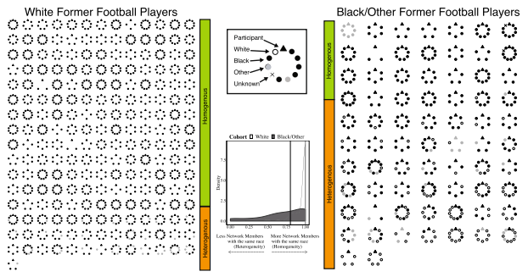
Results: Diversity Of Race

Slide 34
Results: Network Structure Stratified By Chronic Illness
Check whether players without health problems had more robust network structure than those with chronic illnesses (maybe they boosted numbers of players and all players have robust networks then diminish with chronic illness)
Players with no illness and those with illness
No structural difference
Players with no illness compared to those with 1, 2, 3 or more
No structural difference between all groups
Players with no illness compare to those with sleep apnea, pain, cardiometabolic
No distinct structural differences between all groups
There is similar network structure among football players with chronic illness and those without chronic illness

Slide 35
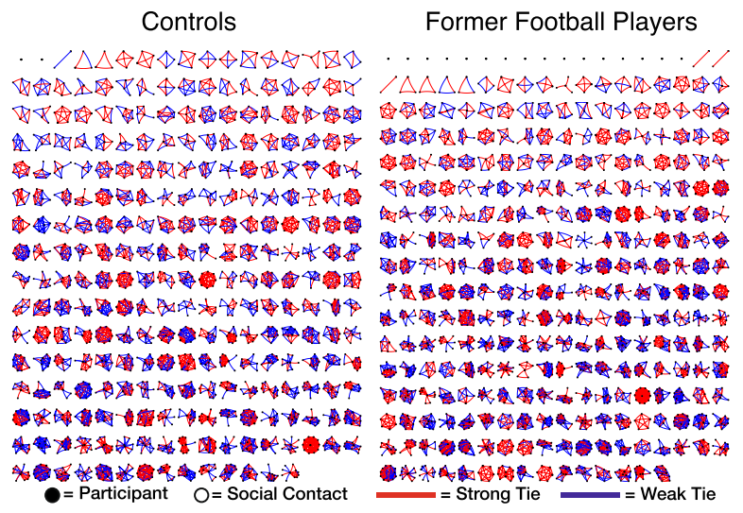
Results: Social Network Sizes

Slide 36
Discussion
Network structure differs from many studies of social behavior in populations with brain trauma and chronic illnesses
Most showed diminished social relationships and constricted social networks
Male dominant, friendship-oriented, and racially diverse network pattern has been seen before in studies of co-workers
Work environment provides opportunities to create bonds among non-family that are homogenous over sex and education and heterogeneous in race and religion
Since these homogenous ties are more resilient over time, this may be why we saw the network structure persist
Large social networks seem to be a protective mechanism during stress and biological changes shown before in reducing the effects of dementia and Alzheimers
Providing social support and using the strong allegiances of former athletes could help with social connectedness therapies to decrease the effects of brain trauma

Slide 37
Discussion: Limitations
Two groups were general in the sense of that they were not matched based on age and race
People who are more sociable may have been more likely to complete the survey
Most people who completed the survey were older and more likely to be white which could limit generalizability
Participants self reported their social networks which usually is accurate but there could have been recall bias where they may have added or omitted details from the past
Network change could not be assessed as well
Overall, NFL players had social networks that were compositionally different but structurally similar to those of US males

Slide 38
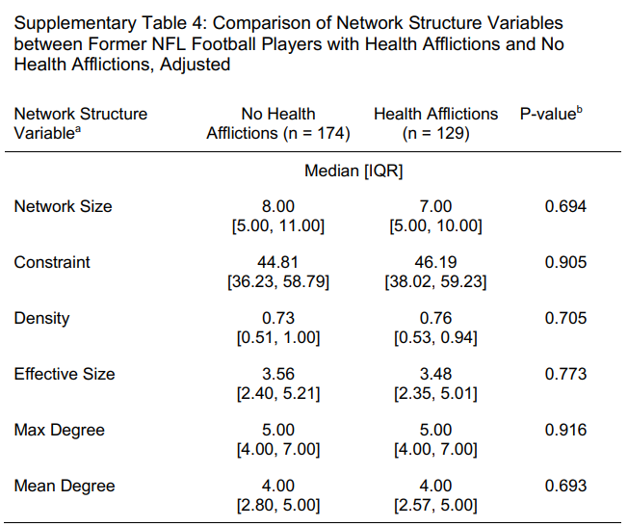
Chronic Illness and No Chronic Illness Structurally

Slide 39
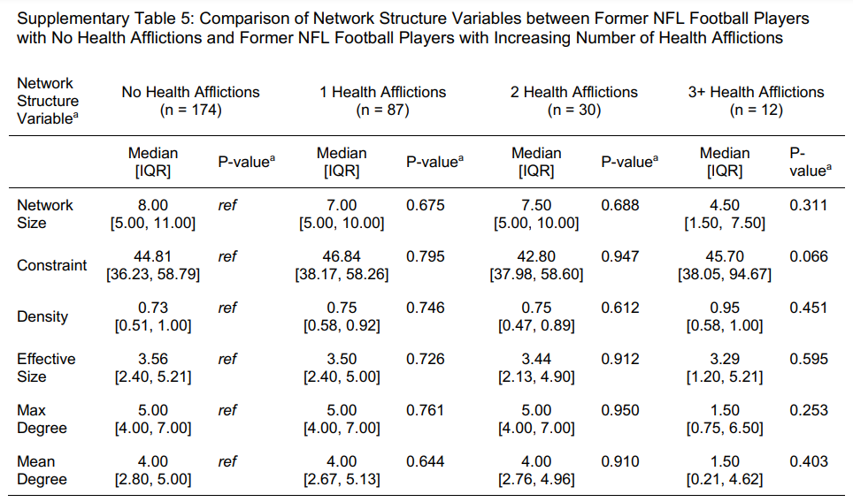
Chronic Illness and No Chronic Illness Structurally

Slide 40
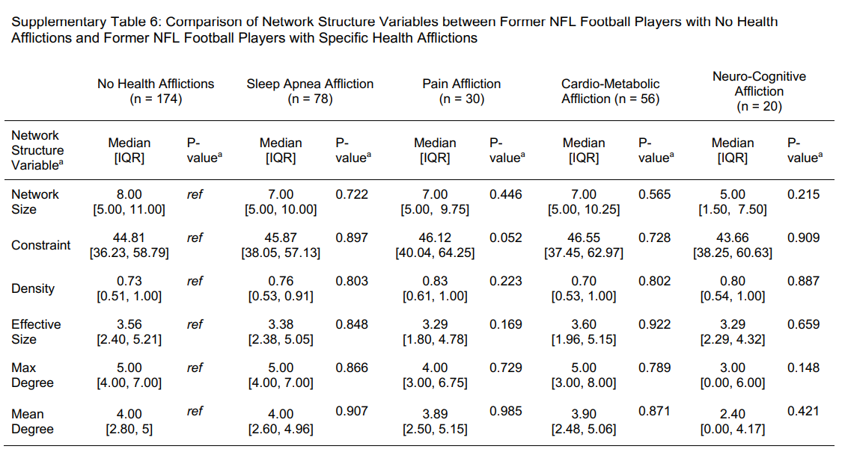
Chronic Illness and No Chronic Illness Structurally

Slide 41
Conclusions
NFL Players and US Controls have networks that do not differ much structurally but are distinct compositionally
Players with chronic illness and without chronic illness still have structurally similar networks
Slight differences among those with neuro-cognitive afflictions could be amplified in a more general study
Compositional studies should be focused on
NFL Players should seek social support and social connectedness therapy as additional treatment for brain trauma and chronic illnesses

Slide 42
Questions?

